Slide 1
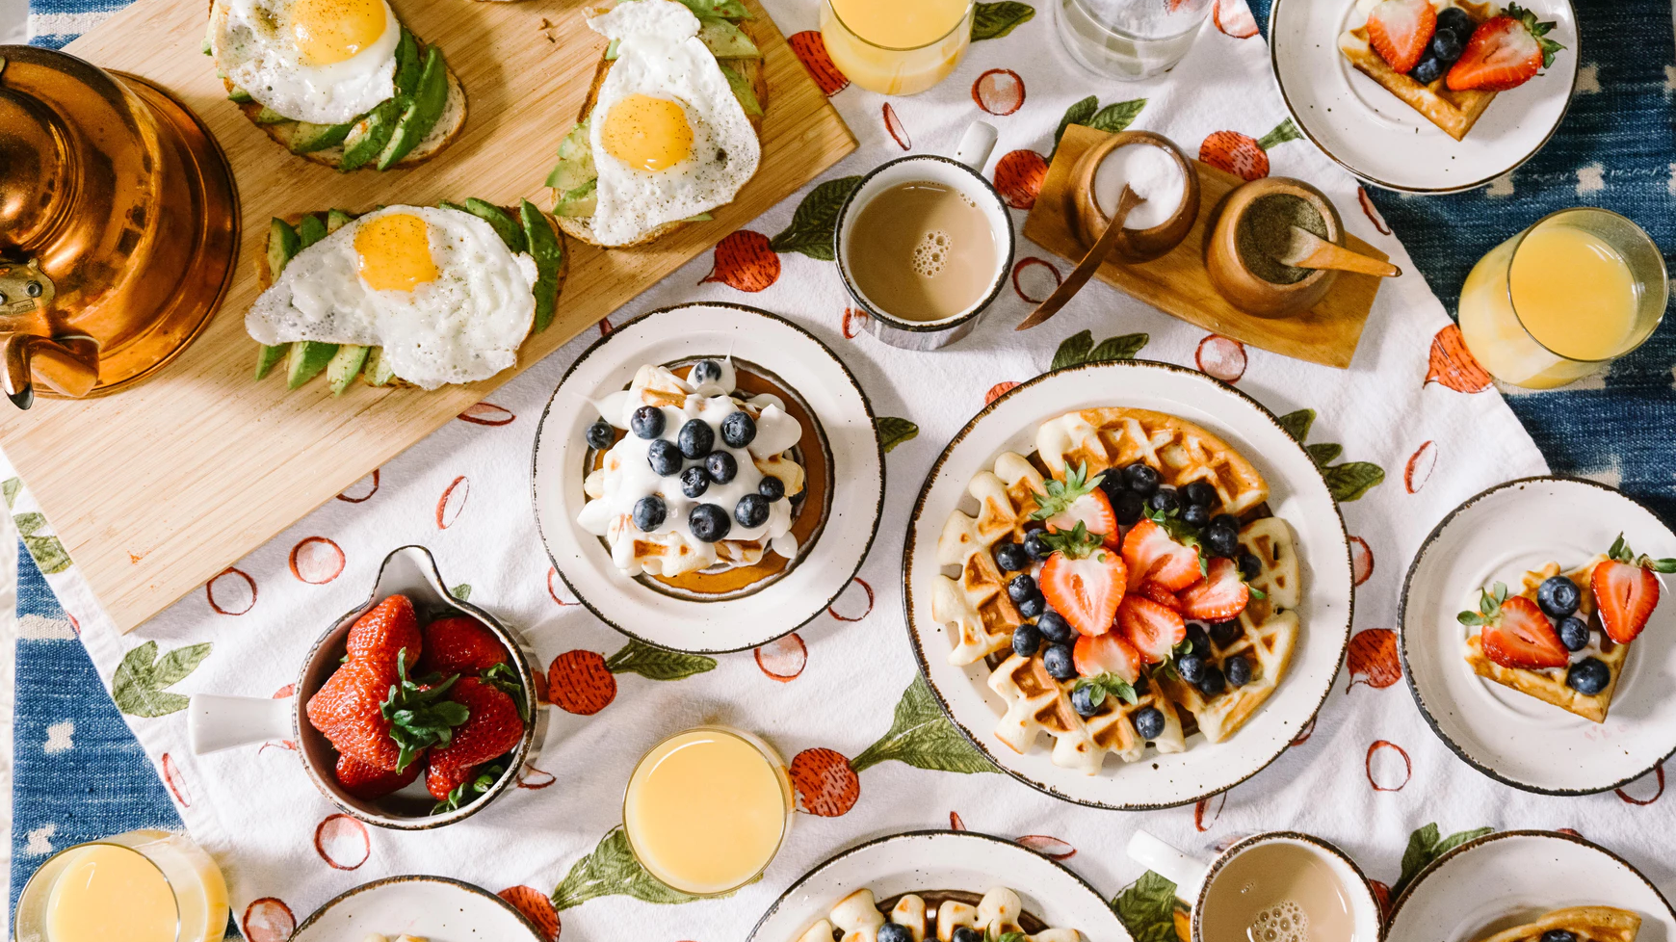

Enhancing DoorDash Customer Satisfaction and Revenue: Optimizing Delivery Efficiency
Capstone Project by Trang Nguyen & Qi Wang
Professor: Rui Sun
Mercer University Stetson School of Business
Notes:
Optimizing DoorDash Delivery Efficiency Through Machine Learning Techniques

Slide 2

Agenda
Introduction
Objective
Approach
Results
Recommendations
Introduction
Objective
Approach
Results
Recommendations
Notes:
Add Page numbers on each slide

Slide 3


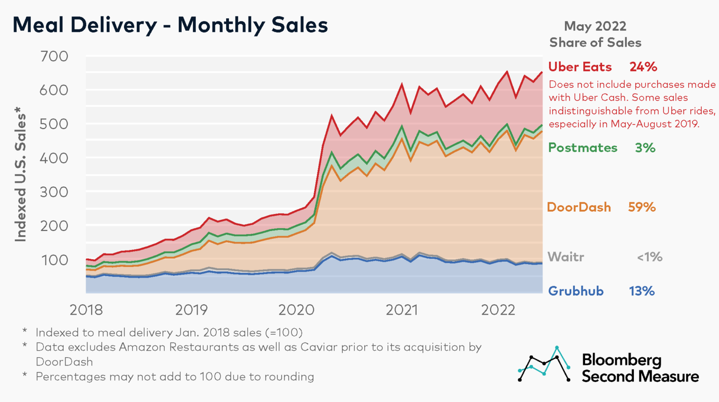
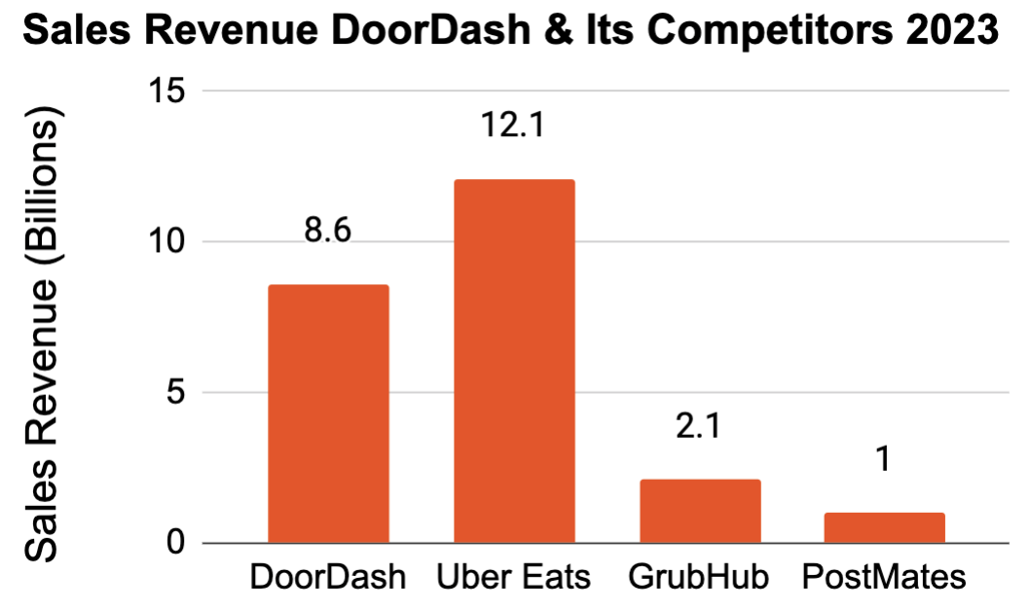
What is DoorDash?
BACKGROUND
COMPETITORS
DoorDash is a convenient on-demand food delivery application that enables customers to order food and beverages from local restaurants within a specified radius [1].
30 countries
450,000 merchants
20,000,000 consumers
One million delivery couriers
UBER EATS
Source: Bloomberg Second Measure [2]
Source: Statista [3]
Introduction
Objective
Approach
Results
Recommendations
Notes:
Think about the word "marketing"?

Slide 4



DoorDash Operational Model
Orders sent to merchant
Merchant
Customer order
2a
Customer
1
DoorDash
3
Dashers pick up orders
2b
4
Dashers drop off orders to customer
Dasher
Orders sent to dasher
Source: DoorDash Company
Introduction
Objective
Approach
Results
Recommendations
Notes:
Make the doordash logo smaller
How would you use this slide to motivate your project?
Optimize the step 1. 2a 2b 3 4 in this project.

Slide 5


Objective
Identify Influencing Factors
Analyze and determine the main factors affecting delivery efficiency and enhance the overall delivery process
Formulate Strategic Recommendations
Present strategies and approaches to optimize the total delivery time and increase profits
Introduction
Objective
Approach
Results
Recommendations
Notes:
Think about the word "marketing"?

Slide 6
Analytical Approach
Feature Selection
Cleaning Data
Predictive Models
Total Delivery Duration of DoorDash Orders
Recommendations
Relationship Analysis
Introduction
Objective
Approach
Results
Recommendations
Notes:
What do you do with clustering analysis?

Slide 7
Data
Data Source
Additional Variables
Originated from DoorDash and was acquired through StrataScratch
197,428 records of customer orders through the DoorDash system
16 variables outlining DoorDash operation in 6 cities
Target Variable:
Total delivery duration
Total delivery duration = Received Order – Creation Order
Data Cleaning
6 additional predictor variables
Busy Dashers Ratio
Estimated Non-Preparation Duration
Percent Distinct Item of Total
Price Range
Peak Time
Weekend
56,061 missing values spread across 21,651 records were removed
No duplicate records presented in data
Potential errors and inconsistencies were identified and removed
Outliers were detected and removed
Units of variables related to time and money were converted to mins and dollars
Variables types were transformed into the correct types
Our cleaning dataset: 116,824 observations with 22 variables
Introduction
Objective
Approach
Results
Recommendations
Notes:
Add a preceise definition of total delievry duration.

Slide 8
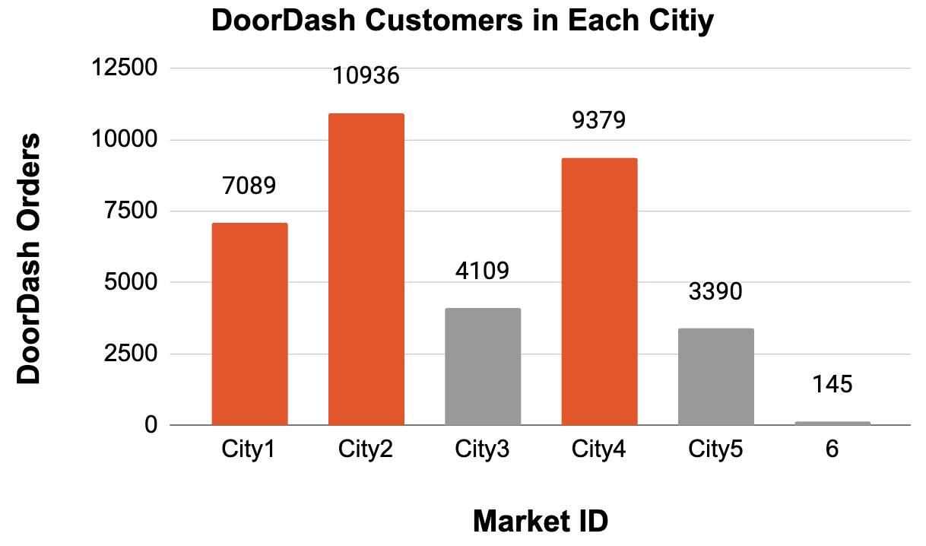
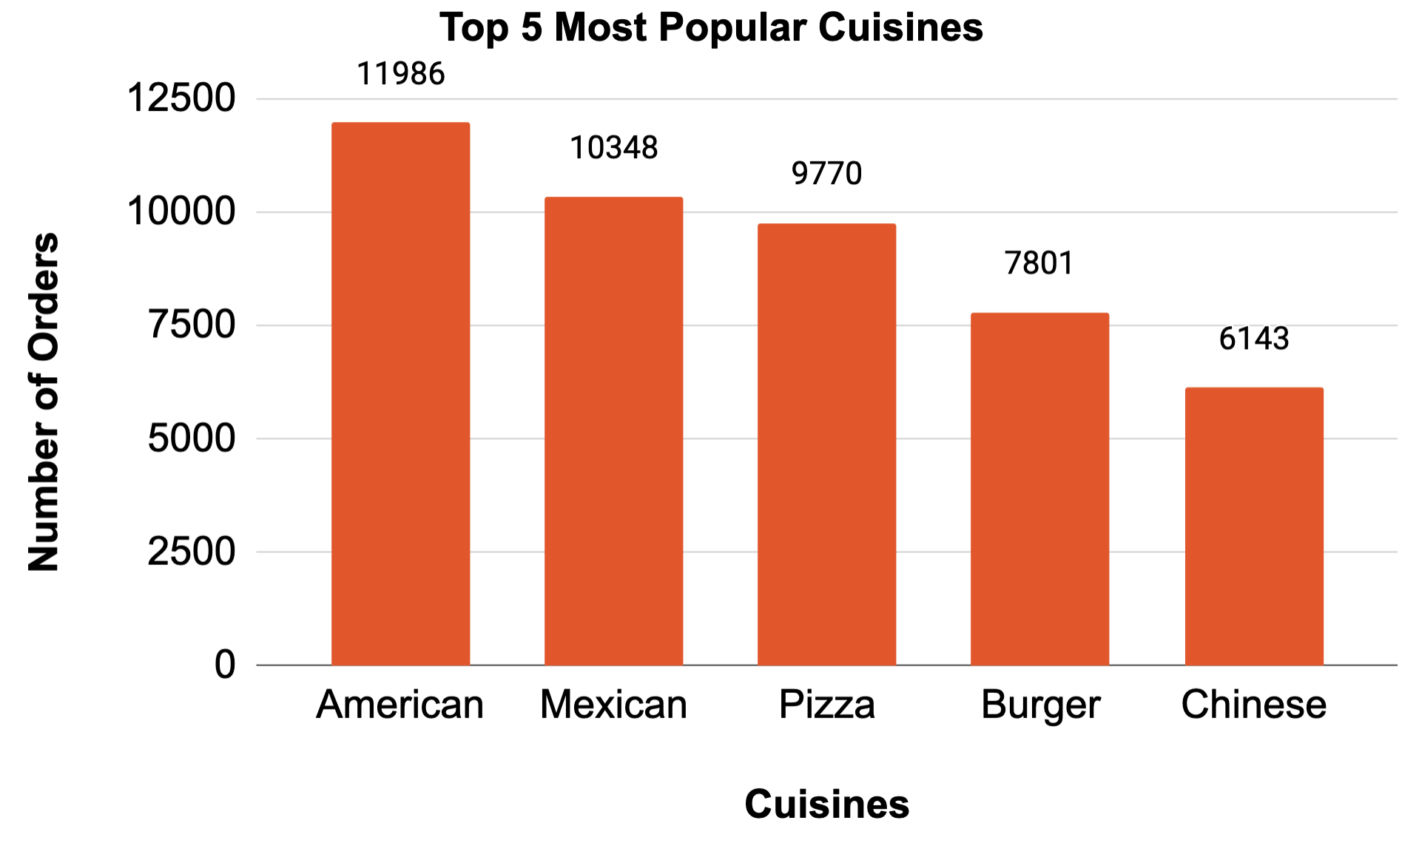
Insights
City4
City3
City1
City5
There are a total of 71 types of cuisines
Introduction
Objective
Approach
Results
Recommendations
Notes:
Use a pie chart for the "cities"
What insights you can get from different cities?
Show less categories so that people can read the labels

Slide 9
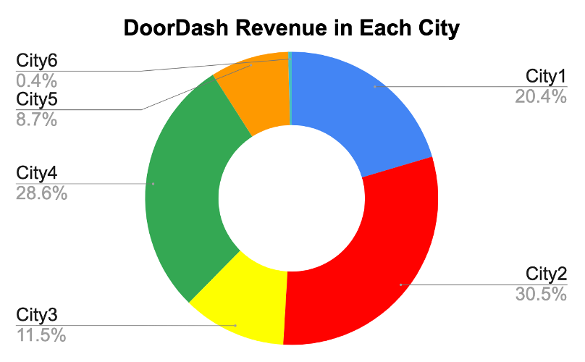
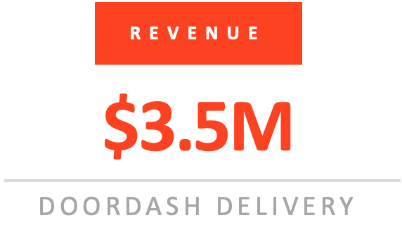
Insights
City4
City3
City1
City5
Introduction
Objective
Approach
Results
Recommendations

Slide 10
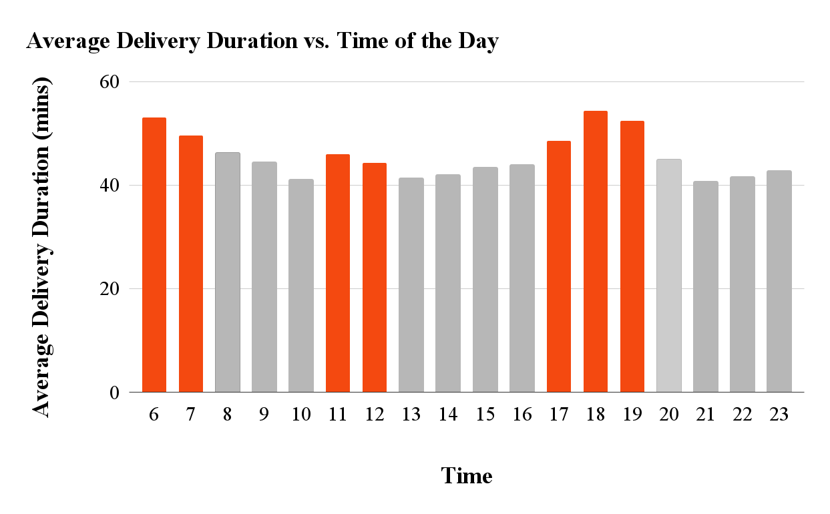
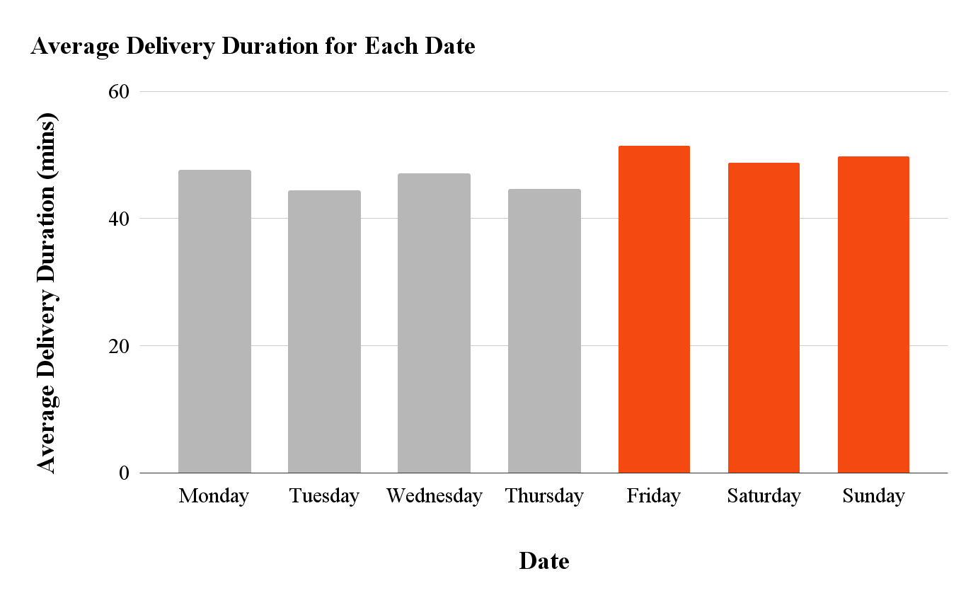
Insights
Introduction
Objective
Approach
Results
Recommendations

Slide 11
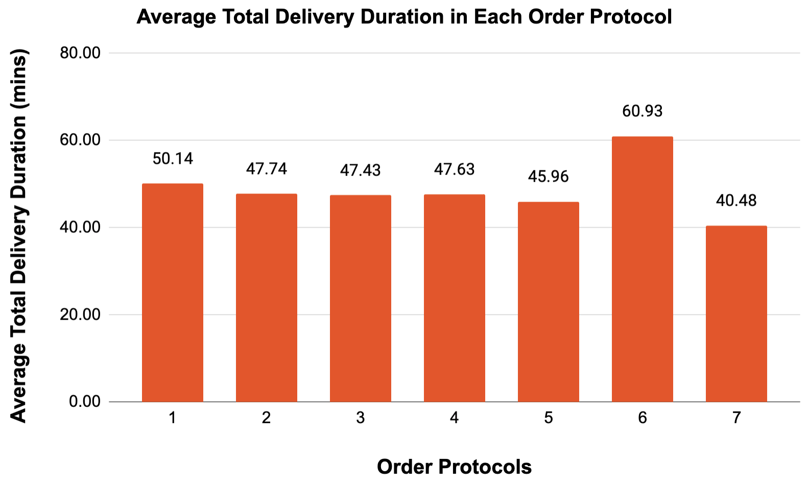
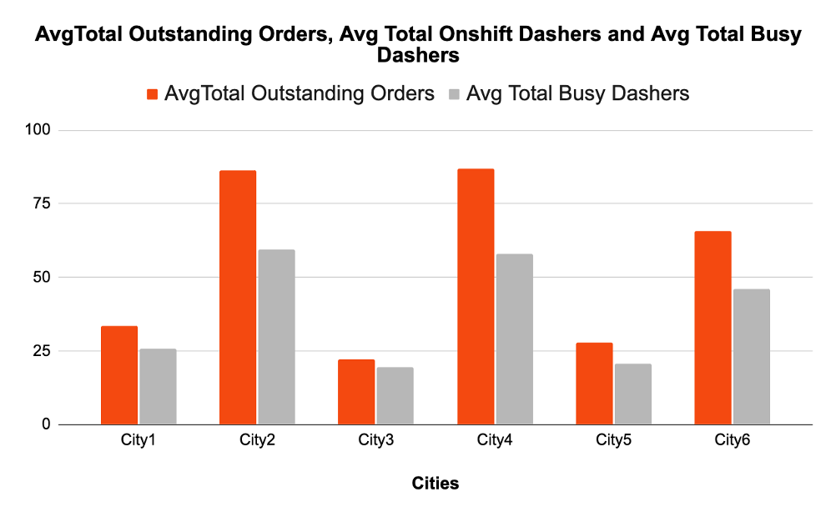
Insights
Customers who order through order protocol 6 will receive their orders in approximately 60 minutes
There is an imbalance in demand and supply, with high customer demand but low Dasher availability in these cities.
Introduction
Objective
Approach
Results
Recommendations
11

Slide 12

Analytical Approach
• Wrapper Method: Backward Elimination
• Embedded Method:
Group Lasso
• Multiple Linear Regression (MLR)
• Regression Tree
• Random Forest
• Gradient Boosting Machine (GBM)
• Extreme Gradient Boosting (XGBoost)
• Light Gradient Boosting Machine (LightGBM)
• Support Vector Regression (SVR)
Introduction
Objective
Approach
Results
Recommendations

Slide 13
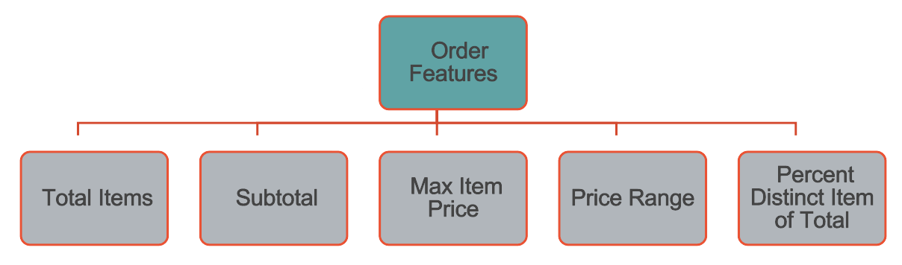
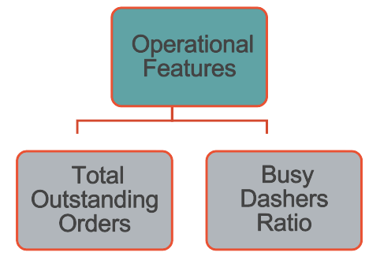
Selected Features
Target Variables
Total Delivery Duration
Predictor Variables
Time Features
Time Peak
Weekend Peak
Store Features
Market ID
Geography Features
Store Primary Category
Order Protocol
Estimate Non-Preparation Duration
Predictor Variables
Introduction
Objective
Approach
Results
Recommendations
Notes:
Selected Features

Slide 14
Model Evaluation
Metrics | MLR | Reg Tree | RF | GBM | XGBoost | LightGBM | SVR
RMSE | 14.6702 | 15.4257 | 14.3540 | 14.2936 | 14.1853 | 14.1674 | 14.515
MAE | 11.1544 | 11.806 | 10.9245 | 10.8546 | 10.7706 | 10.7548 | 10.9826
Accuracy
LightGBM
Efficiency
Introduction
Objective
Approach
Results
Recommendations
13
Notes:
Put the right half of slide 8 before slide 13 as a seperate slide
Make clear what you mean by efficiency

Slide 15

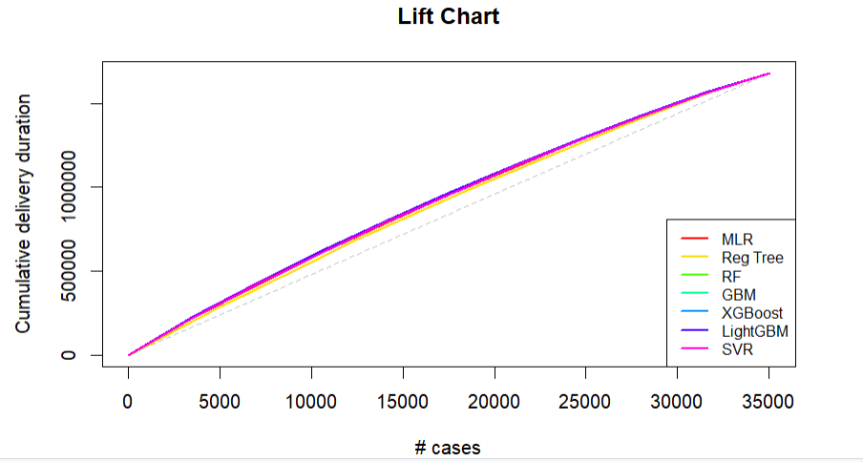
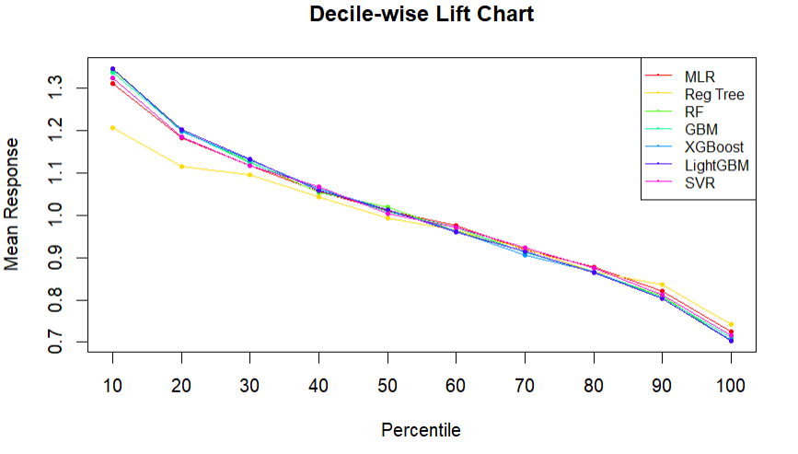
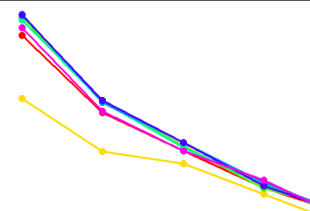
Model Evaluation
More effective at predicting longer delivery duration in top 40% of cases than random chance.
Introduction
Objective
Approach
Results
Recommendations
14

Slide 16
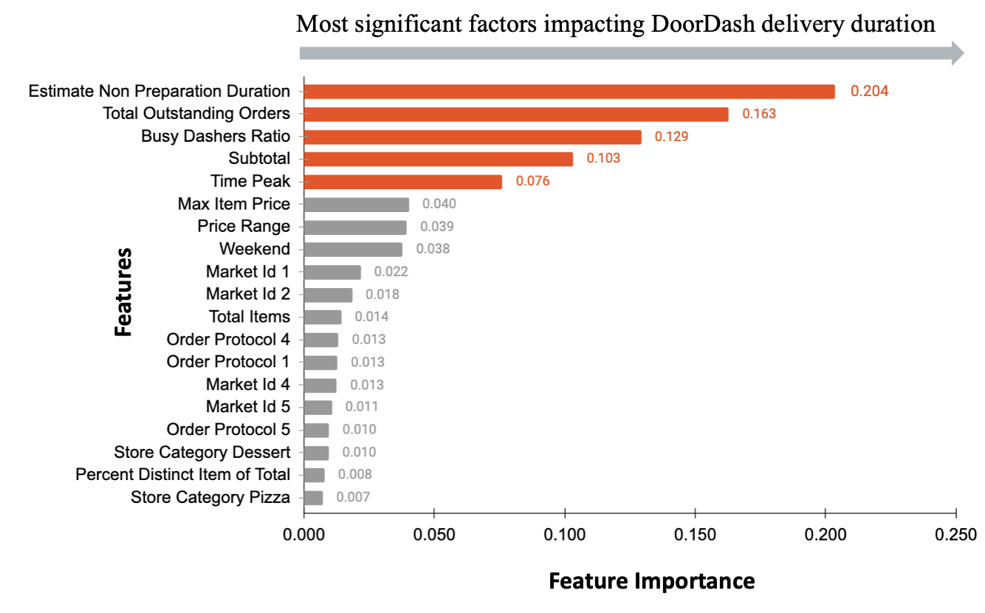
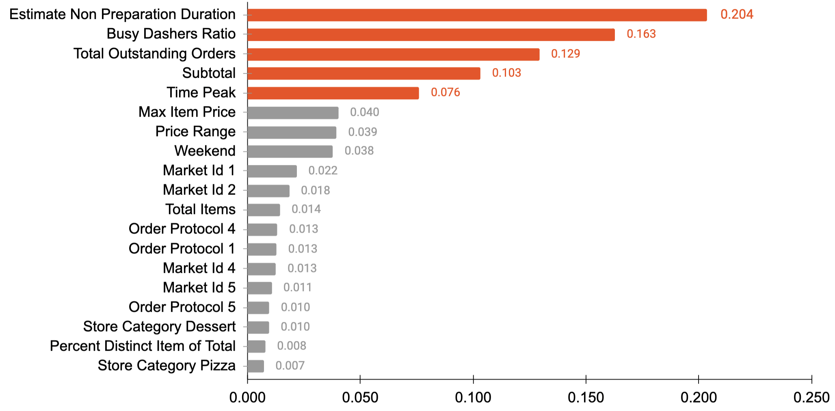
Key Factors Analysis
Five most significant factors impacting the total delivery duration are Estimate Non-Preparation Duration, Busy Dashers Ratio, Total Outstanding Order, Subtotal, and Time Peak
Introduction
Objective
Approach
Results
Recommendations
15

Slide 17
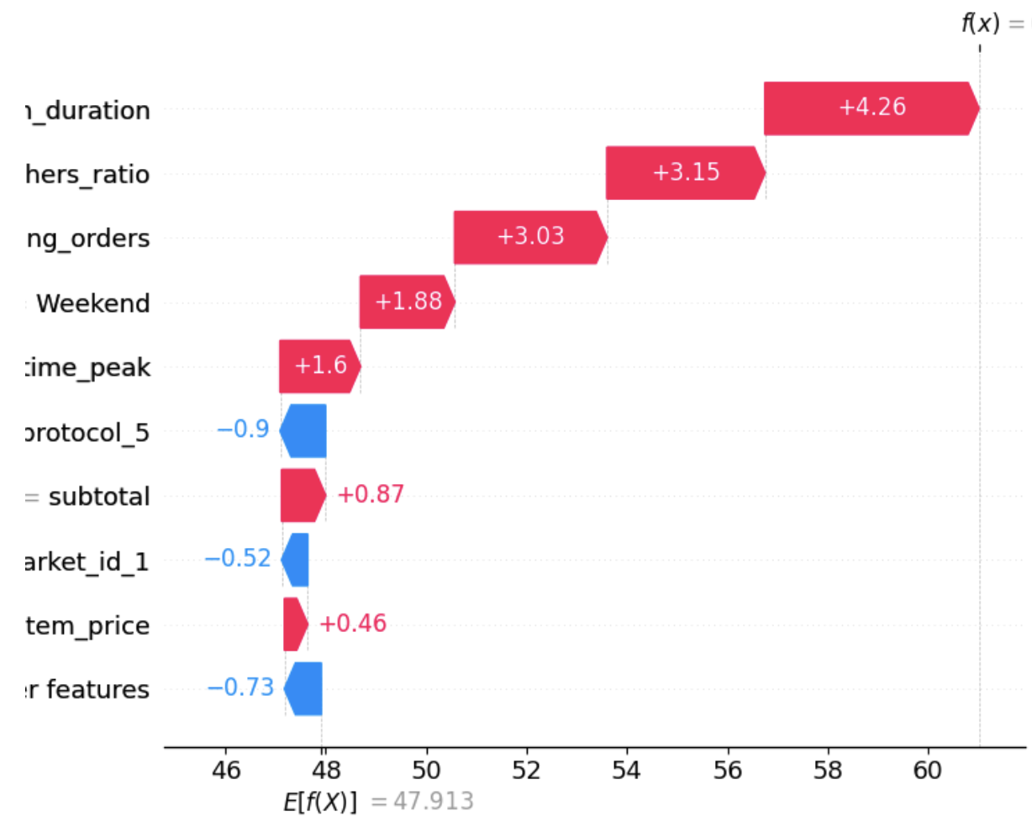
SHAP (SHapley Additive exPlanations) Value Analysis
Waterfall Plot: Significant Features
f(X) = 61.013
17.58 = Estimate Non-Preparation Duration
1.0 = Busy Dashers Ratio
The Average Predicted Total Delivery Duration across 81,776 order records is 47.913 minutes.
Predicted Total Delivery Time for a particular order record is 61.013 mins.
97 = Total Outstanding Orders
1 = Weekend
1 = Time Peak
Features
1 = Order Protocol 5
35.72 = Subtotal
For every minute increase in Non-Preparation Duration, the total delivery duration until customers receive their order will be 4.26 minutes longer.
0 = Market ID 1
14.4. = Max Item Price
85 Other Features
Base Value = E[f(X)] = 47.913
Introduction
Objective
Approach
Results
Recommendations
16

Slide 18

"Real World" Predictions
 | Market ID | Store Primary Category | Order Protocol | Total Items | Subtotal | Max Item Price | Total Outstanding Orders | Busy Dashers Ratio | Estimate Non Preparation Duration | Percent Distinct iIem of Total | Price Range | Time Peak | Weekend
A | 3 | Sandwich | 5 | 2 | 12.11 | 10.42 | 18 | 0.75 | 7.12 | 50 | 0.33 | 0 | 0
B | 2 | Mexican | 2 | 3 | 12.24 | 11.99 | 174 | 0.88 | 12.85 | 66.67 | 7.74 | 1 | 0
C | 1 | American | 3 | 6 | 52.17 | 13.18 | 197 | 1 | 19.27 | 100 | 8.29 | 1 | 1
Total Delivery Duration
Case A: 25.80 mins
Case B: 47.76 mins
Case C: 70.02 mins
Introduction
Objective
Approach
Results
Recommendations

Slide 19
Recommendations
Optimize Dasher Allocation
Increasing the number of Dashers during peak times and in high-demand locations
Continuous monitoring Outstanding Orders
Dasher Rewards Program
Implementing a rewards program for Dashers working during high-demand periods
Dedicated Delivery Teams
Establishing dedicated delivery teams for high-value or large orders
Improved Order Dispatch System
Automatically adjusting pickup times for complex orders
Multi-Modal Delivery Options
Implement multi-modal delivery options like drones, electric bicycles, motorcycles, and walkers
Data-Driven Decision Making
Using data-driven methods to further analyze different markets and store categories to optimize operation
Introduction
Objective
Approach
Results
Recommendations

Slide 20
References
[1] Exploring Door Dash: Everything You Need to Know. https://medium.com/@social.restaurantify01/exploring-door-dash-everything-you-need-to-know-1958dae2d98c
[2] How did DoorDash win the Food Delivery Wars? https://www.aakashg.com/doordash/
[3] Annual revenue of DoorDash from 2019 to 2023. https://www.statista.com/statistics/1294498/doordash-annual-revenue/#:~:text=In%202023%2C%20DoorDash%20generated%20approximately,2013%20in%20Palo%20Alto%2C%20California.

Slide 21

Thank You.

Slide 22
Appendix
Original data: 197,428 observations with 16 variables
No duplicates
56061 Missing values
987 market_id
7 actual_delivery_time
4760 store_primary_category
16262 total_busy_dashers
995 order_protocol
16,262 total_onshift_dashers
16,262 total_outstanding_orders
526 estimated_store_to_consumer_driving_duration

Slide 23
Data Dictionary of Original Variables
Variable Name | Variable Type | Unit of Measurement | Description
market_id | Categorical | ID | The unique identifier for the city/region where DoorDash operates.
created_at | Timestamp | UTC | The date and time when the consumer submitted the order.
actual_delivery_time | Timestamp | UTC | The date and time when the order was delivered to the consumer.
store_id | Categorical | ID | The unique identifier representing the restaurant for which the order was submitted.
store_primary_category | Categorical | NA | The cuisine category of the restaurant.
order_protocol | Categorical | ID | The protocol ID through which the store receives orders from DoorDash.
total_items | Numerical | Items | The total number of items in the order.
subtotal | Numerical | Cents | The total value of the order submitted.
num_distinct_items | Numerical | Items | The number of distinct items included in the order.
min_item_price | Numerical | Cents | The price of the item with the least cost in the order.
max_item_price | Numerical | Cents | The price of the item with the highest cost in the order.
total_onshift_dashers | Numerical | Dashers | The number of available dashers who are within 10 miles of the store at the time of order creation.
total_busy_dashers | Numerical | Dashers | The subset of onshift dashers who are currently working on an order.
total_outstanding_orders | Numerical | Orders | The number of orders within 10 miles of this order that are currently being processed.
estimated_order_place_duration | Numerical | Seconds | The estimated time for the restaurant to receive the order from DoorDash.
estimated_store_to_consumer_ driving_duration | Numerical | Seconds | The estimated travel time between the store and the consumer.

Slide 24
Data Dictionary of Selected Variables
Variable Name | Variable Type | Unit of Measurement | Description
market_id | Categorical | ID | The unique identifier for the city/region where DoorDash operates.
store_primary_category | Categorical | NA | The cuisine category of the restaurant.
order_protocol | Categorical | ID | The protocol ID through which the store receives orders from DoorDash.
total_items | Numerical | Items | The total number of items in the order.
subtotal | Numerical | Dollars | The total value of the order submitted.
total_delivery_duration | Numerical | Minutes | The target variable, created by subtracting the created_at timestamp from the actual_delivery_time.
time_peak | Binary | NA | 1 if the order creation time is during peak hours (6-9 AM, 11 AM-1 PM, 5-8 PM); 0 otherwise.
max_item_price | Numerical | Dollars | The price of the item with the highest cost in the order.
Weekend | Binary | NA | 1 if the order creation time falls on Friday, Saturday, or Sunday; 0 for other days.
total_dashers_ratio | Numerical | Percentage | The ratio of busy dashers to the total dashers on shift.
total_outstanding_orders | Numerical | Orders | The number of orders within 10 miles of this order that are currently being processed.
estimated_non_ preparation_duaration | Numerical | Minutes | The sum of the time estimated for the restaurant to receive the order from DoorDash and the estimated travel time between the store and the consumer.
percent_distinct_item_of_total​ | Numerical | Percentage | The proportion of unique items within the total number of items. It is calculated by dividing the number of distinct items by the total number of items.
price range | Numerical | Dollars | The difference between the highest and lowest item prices in an order, indicating the range of item prices.

Slide 25
Data Dictionary of Selected Variables
Order Protocol: method of how orders are transmitted from the DoorDash platform to the store.
Middleware Integration: Uses intermediary software to connect DoorDash with the store's systems.
Direct POS Integration: Connects DoorDash directly to the store's POS system in real-time, streamlining order processing without the need for intermediary software.

Slide 26
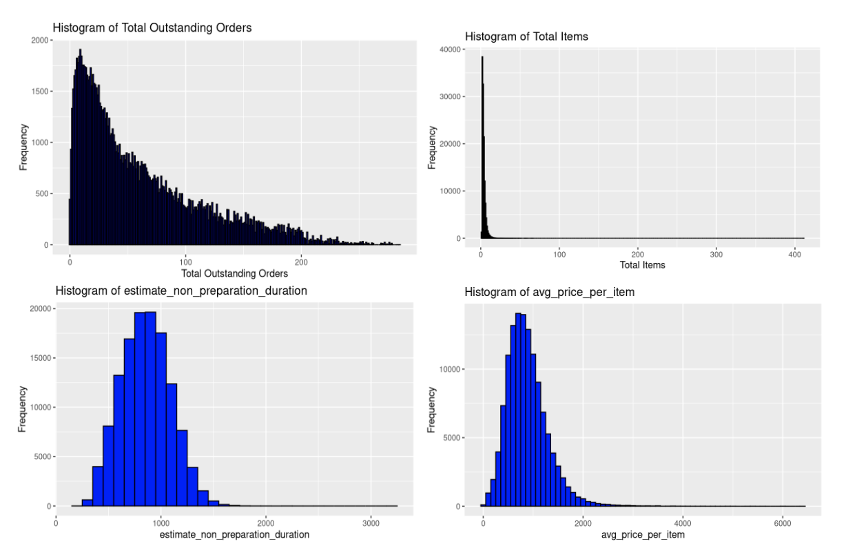
Histograms of Data Distribution

Slide 27
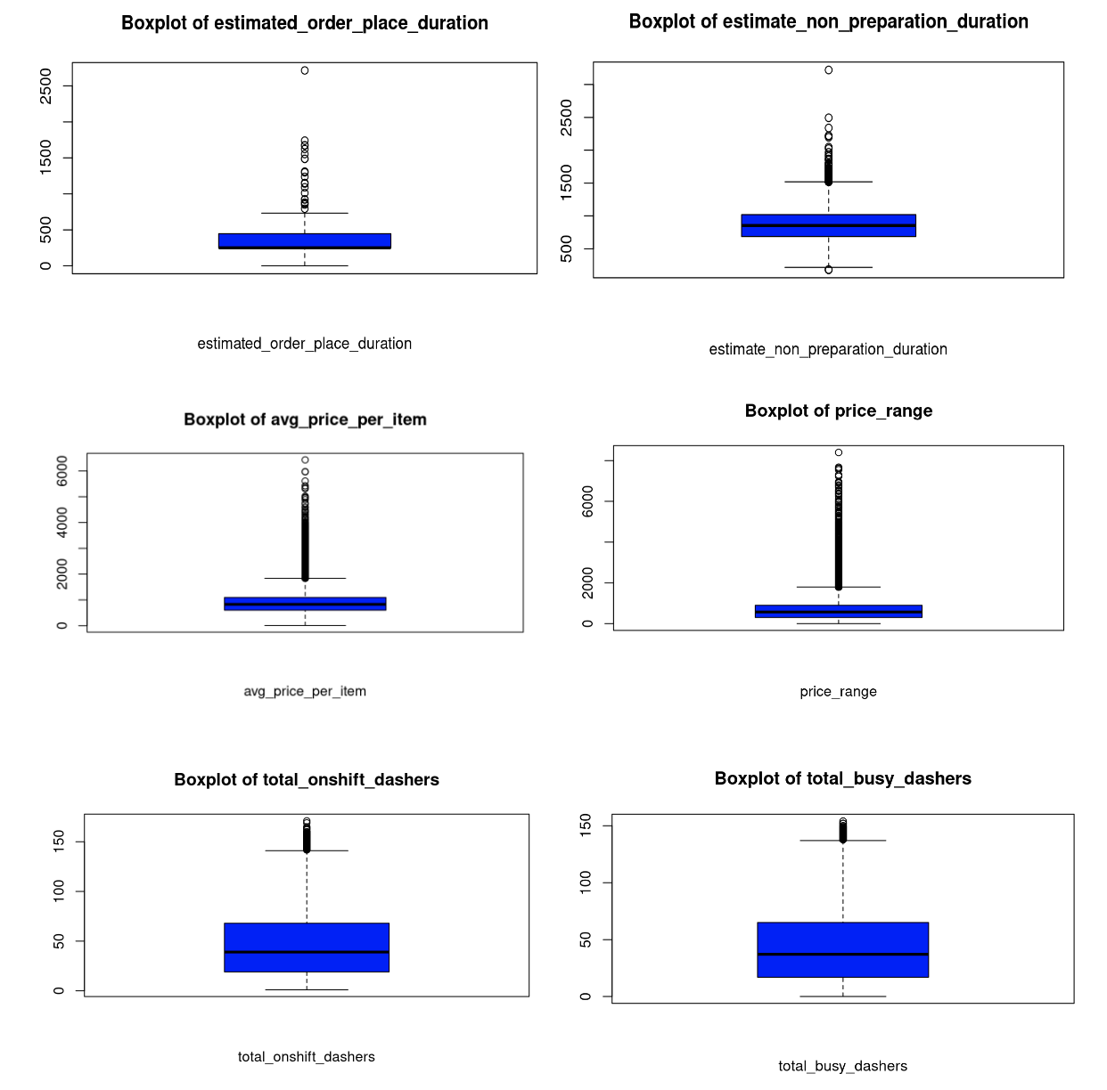
Box Plots of Numerical Variables

Slide 28
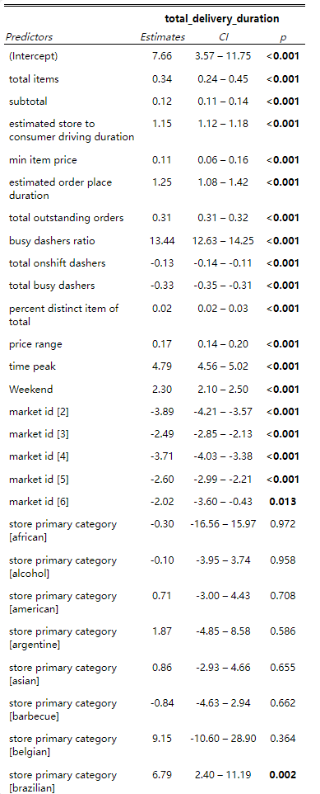
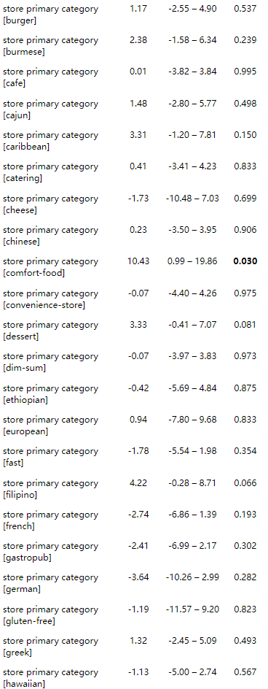
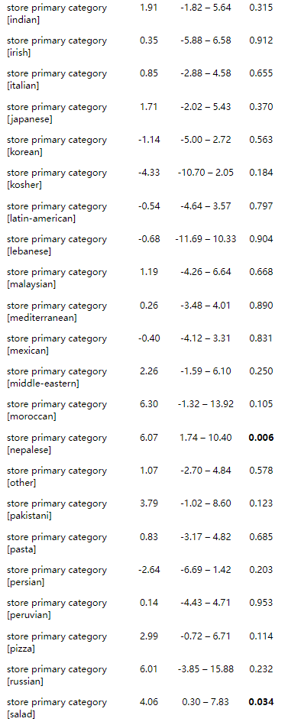
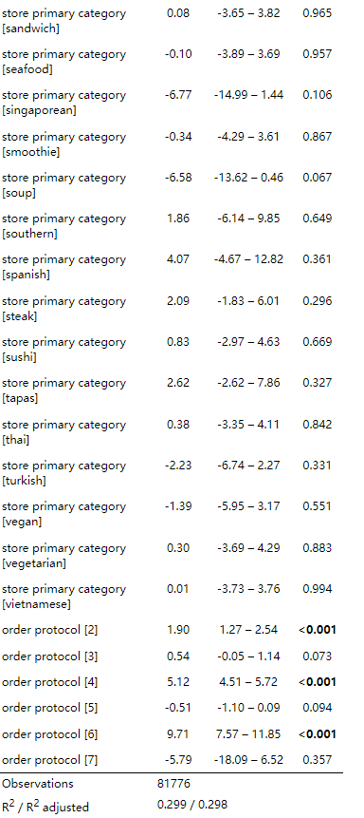
Results for Backward Elimination

Slide 29
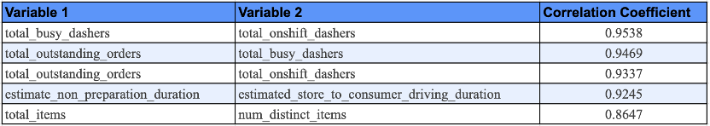
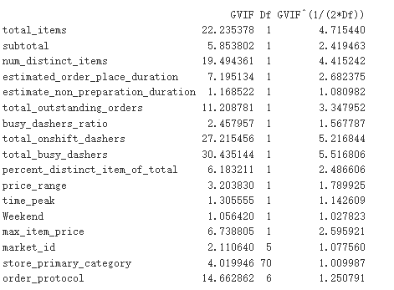
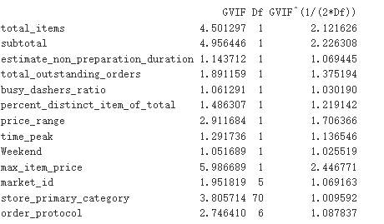
High Correlation Coefficients between Variables
Variance Inflation Factor (Before)
Variance Inflation Factor (After)

Slide 30
Significant Coefficients of Group Lasso Regression
Significant Coefficients by Group Lasso
Coefficient
(Intercept) | 8.789712
market_id2 | -3.85613
market_id3 | -2.46786
market_id | -3.65335
market_id5 | -2.55856
market_id6 | -2.00511
order_protocol2 | 1.744677
order_protocol3 | 0.417712
order_protocol4 | 4.8569
order_protocol5 | -0.61252
order_protocol6 | 9.653102
order_protocol7 | -5.78277
store_primary_categoryafrican | -0.2186
store_primary_categoryalcohol | -0.11125
store_primary_categoryamerican | 0.676869
store_primary_categoryargentine | 1.84559
store_primary_categoryasian | 0.82346
store_primary_categorybarbecue | -0.80835
store_primary_categorybelgian | 8.741839
store_primary_categorybrazilian | 6.50149
store_primary_categorybreakfast | -1.55919
store_primary_categorybritish | -1.16245
store_primary_categorybubble-tea | 6.496042
store_primary_categoryburger | 1.137357
Significant Coefficients by Group Lasso (cont.)
Coefficient
store_primary_categoryburmese | 2.253313
store_primary_categorycafe | 0.082652
store_primary_categorycajun | 1.407782
store_primary_categorycaribbean | 3.196227
store_primary_categorycatering | 0.376852
store_primary_categorycheese | -1.62414
store_primary_categorychinese | 0.210265
store_primary_categorycomfort-food | 9.9437
store_primary_categoryconvenience-store | 0.058874
store_primary_categorydessert | 3.159223
store_primary_categorydim-sum | -0.09558
store_primary_categoryethiopian | -0.36917
store_primary_categoryeuropean | 0.924882
store_primary_categoryfast | -1.57301
store_primary_categoryfilipino | 4.012658
store_primary_categoryfrench | -2.61694
store_primary_categorygastropub | -2.29799
store_primary_categorygerman | -3.4432
store_primary_categorygluten-free | -1.1456
store_primary_categorygreek | 1.227479
store_primary_categoryhawaiian | -1.08865
store_primary_categoryindian | 1.816362
store_primary_categoryirish | 0.343758
store_primary_categoryitalian | 0.803077
Significant Coefficients by Group Lasso (cont.)
Coefficient
store_primary_categoryjapanese | 1.625795
store_primary_categorykorean | -1.08578
store_primary_categorykosher | -4.10195
store_primary_categorylatin-american | -0.52089
store_primary_categorylebanese | -0.63984
store_primary_categorymalaysian | 1.14459
store_primary_categorymediterranean | 0.251642
store_primary_categorymexican | -0.40514
store_primary_categorymiddle-eastern | 2.126487
store_primary_categorymoroccan | 5.964333
store_primary_categorynepalese | 5.726119
store_primary_categoryother | 1.010685
store_primary_categorypakistani | 3.581079
store_primary_categorypasta | 0.757592
store_primary_categorypersian | -2.52902
store_primary_categoryperuvian | 0.128994
store_primary_categorypizza | 2.845754
store_primary_categoryrussian | 5.773469
store_primary_categorysalad | 3.876027
store_primary_categorysandwich | 0.073223
store_primary_categoryseafood | -0.12015
store_primary_categorysingaporean | -6.45742
store_primary_categorysmoothie | -0.28425
store_primary_categorysoup | -6.26209
Significant Coefficients by Group Lasso (cont.)
Coefficient
store_primary_categorysouthern | 1.793708
store_primary_categoryspanish | 3.945842
store_primary_categorysteak | 1.985631
store_primary_categorysushi | 0.776012
store_primary_categorytapas | 2.562042
store_primary_categorythai | 0.353314
store_primary_categoryturkish | -2.152
store_primary_categoryvegan | -1.28351
store_primary_categoryvegetarian | 0.279057
store_primary_categoryvietnamese | -0.01568
total_items | 0.213507
subtotal | 0.120944
num_distinct_items | 0.161525
max_item_price | 0.116852
total_onshift_dashers | -0.12778
total_busy_dashers | -0.32257
total_outstanding_orders | 0.310891
estimated_order_place_duration | 0.065877
busy_dashers_ratio | 13.29004
estimate_non_preparation_duration | 1.148948
percent_distinct_item_of_total | 0.015455
price_range | 0.054365
Weekend | 2.295441
time_peak | 4.779835

Slide 31
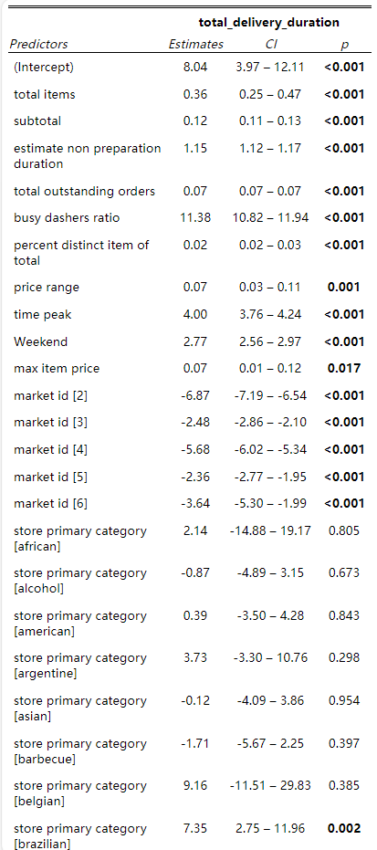
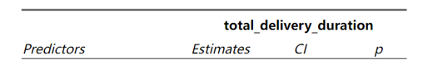
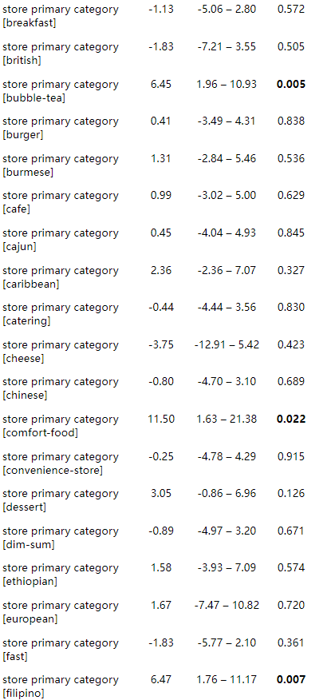
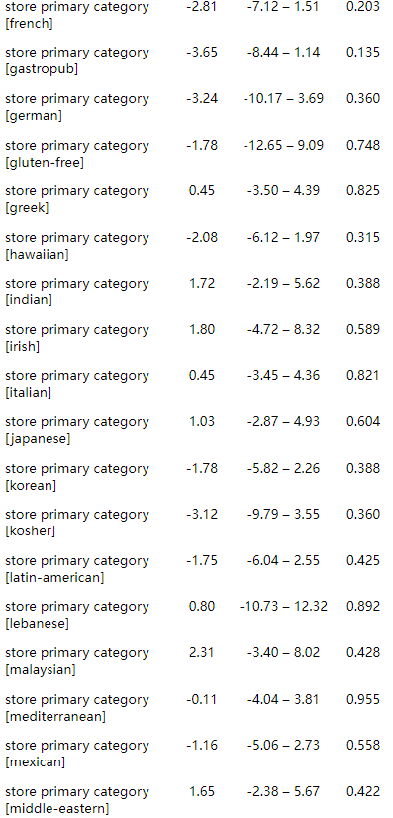
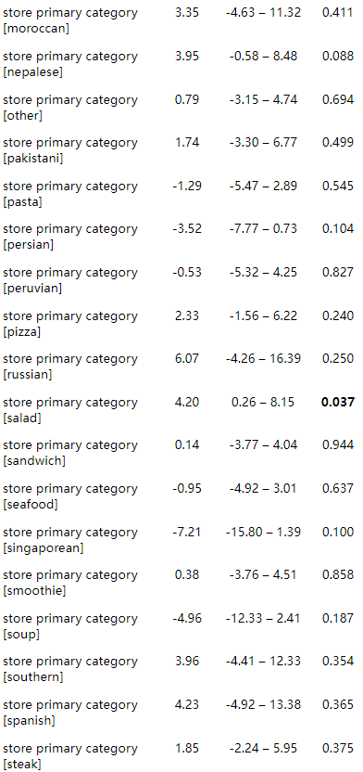
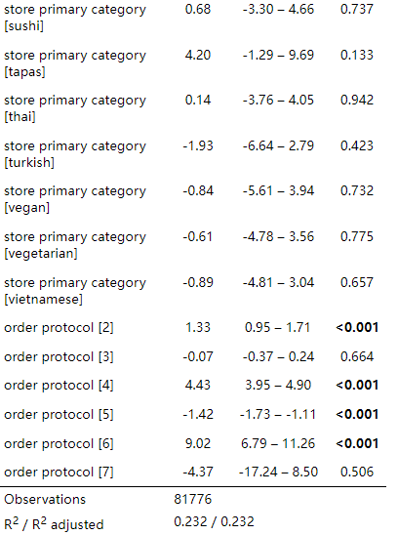
Multiple Linear Regression Results

Slide 32
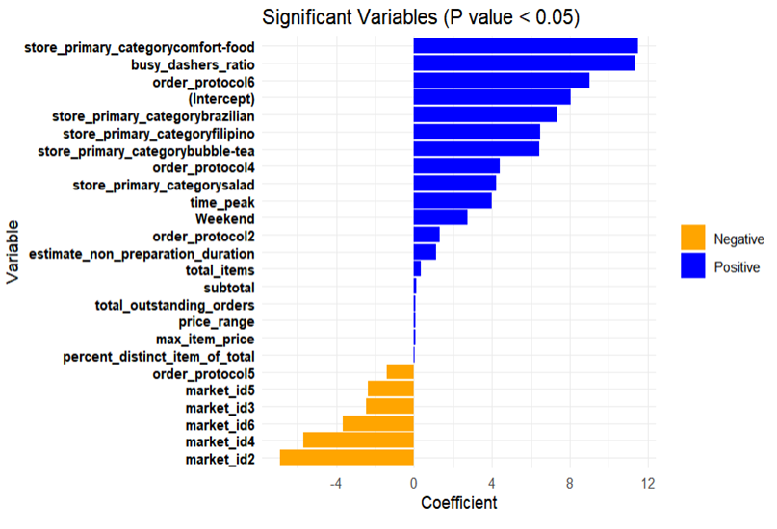
Significant variables in MLR model

Slide 33
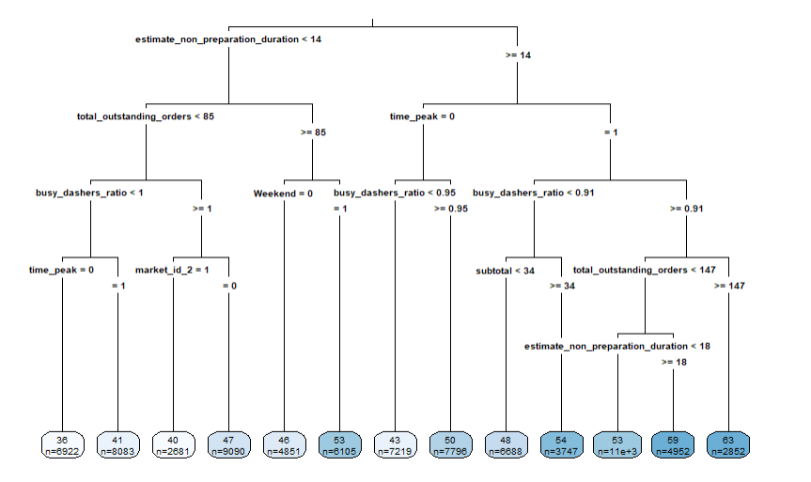
Regression Tree Plot after pruning

Slide 34
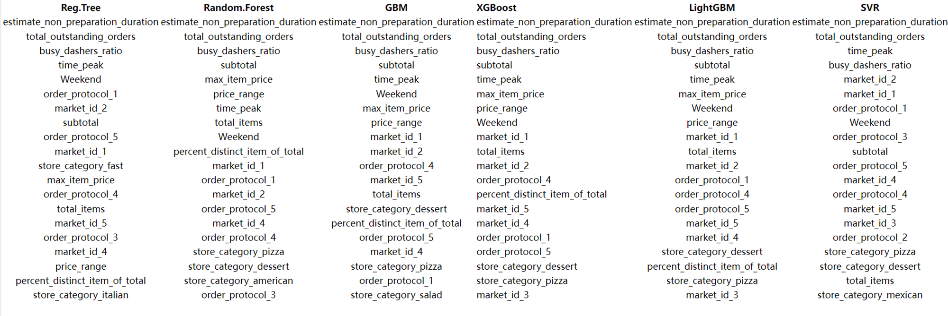
Top 20 Features from Non-Parametric Models

Slide 35
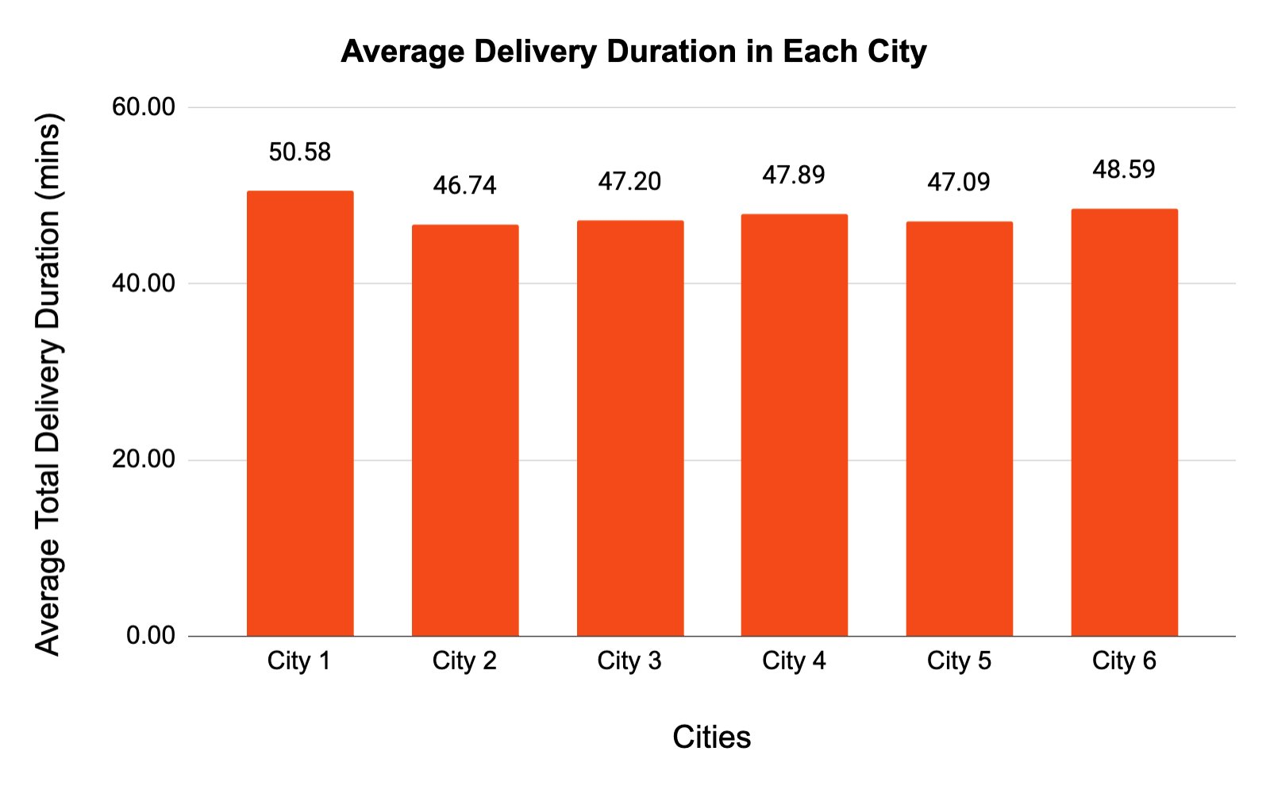
Insights
City4
City2
City3
City1
City5
Introduction
Objective
Approach
Results
Recommendations
Notes:
Use a pie chart for the "cities"
What insights you can get from different cities?
Show less categories so that people can read the labels

